Slide 1
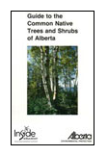
Created by Teacher Katy Rogal from Greystone Centennial Middle School

Slide 2
used with permission from Inside Education

Slide 3
used with permission from Inside Education

Slide 4
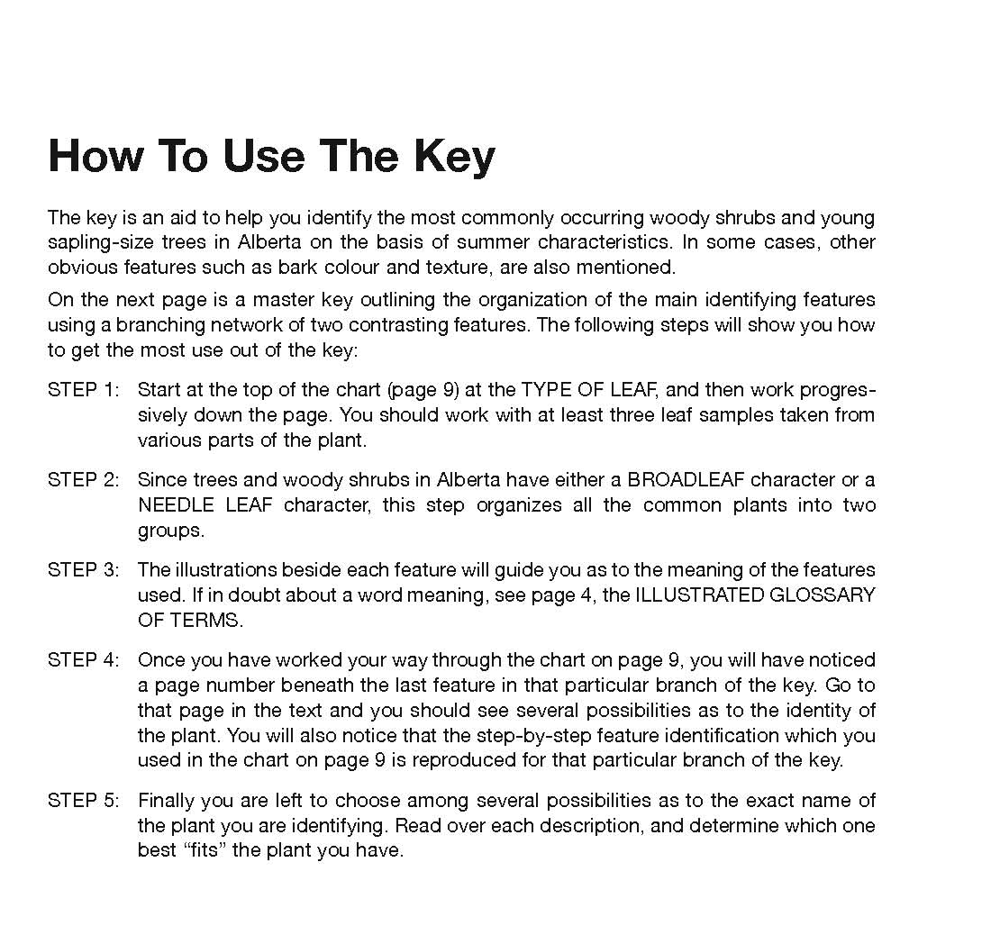
This tree icon is a link to the beginning

Slide 5
used with permission from Inside Education

Slide 6
used with permission from Inside Education

Slide 7
used with permission from Inside Education

Slide 8
used with permission from Inside Education

Slide 9
used with permission from Inside Education

Slide 10
used with permission from Inside Education

Slide 11
used with permission from Inside Education

Slide 12
used with permission from Inside Education

Slide 13
used with permission from Inside Education

Slide 14
used with permission from Inside Education

Slide 15
used with permission from Inside Education

Slide 16
used with permission from Inside Education

Slide 17
used with permission from Inside Education

